Slide 1



For the purpose of Forage virtual experience program
BRITISH
AIRWAYS
CUSTOMER REVIEW ANALYSIS
DATE
January 14, 2024

Slide 2
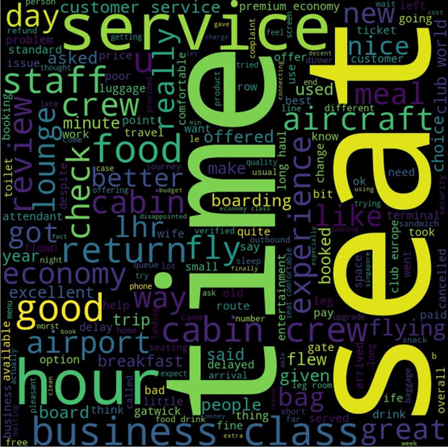
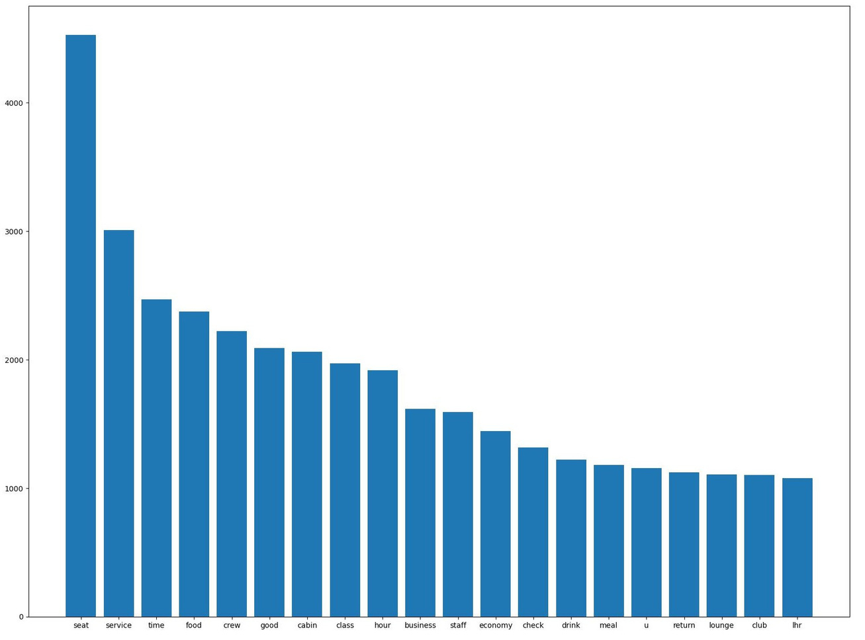
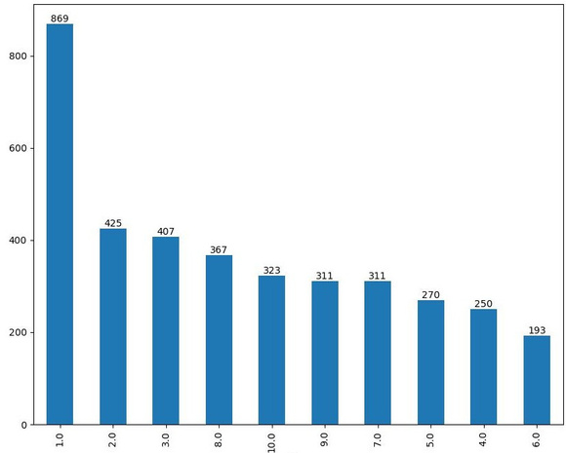
Key Insights
What Customers have to say:
JANUARY 2024
Reviews from
7-10 stars: Premium economy, Leg room, cabin crew, food.
4-6 stars: long haul, cold cheese onion, refused help, lack of storage space.
1-3 stars: middle seat blocked, poor quality screen, worst business class, long haul
3726
72 COUNTRIES
REVIEWS ANALYZED
Focus on:
All passengers liked the cabin crew, seats and the food.
Most of passengers travelled in economy
Improved food quality, Customer service, Quality entertainment, flight scheduling
Rating Counts
5/10
AVERAGE RATING

